Slide 1
Machine learning

Slide 2
Learning
Humans learn from their experience and studies.
Learning is a process of acquiring knowledge or skills from experience, study or being taught.
For example a child updates its knowledge day by day whenever they gather new information. They only add this new information in their existing knowledge instead of relearning from start.
Very similar to this is machine learning process.

Slide 3
What is Machine Learning ?
As it is evident from the name, it gives the computer that which makes it more similar to humans: the ability to learn.
Machine learning is an application of artificial intelligence (AI) that provides systems the ability to automatically learn and improve from experience without being explicitly programmed.
Machine learning focuses on the development of computer programs that can access data and use it learn for themselves.
The primary aim is to allow the computers learn automatically without human intervention or assistance and adjust actions accordingly.
Neural network, support vector machine and other machine learning processes possess incremental learning so as to reduce cost and complexity of system.

Slide 4
Applications of Machine Learning
Web Search Engine: One of the reasons why search engines like google, bing etc work so well is because the system has learnt how to rank pages through a complex learning algorithm.
Photo tagging Applications: Be it facebook or any other photo tagging application, the ability to tag friends makes it even more happening. It is all possible because of a face recognition algorithm that runs behind the application.
Spam Detector: Our mail agent like Gmail or Hotmail does a lot of hard work for us in classifying the mails and moving the spam mails to spam folder. This is again achieved by a spam classifier running in the back end of mail application.

Slide 5
Contd…
Today, companies are using machine learning to improve business decisions, increase productivity, detect disease, forecast weather, and do many more things.
There are various ways to classify machine learning problems.

Slide 6
Supervised learning:
The computer is presented with example inputs and their desired outputs, given by a “teacher”, and the goal is to learn a general rule that maps inputs to outputs.
The training process continues until the model achieves the desired level of accuracy on the training data.
Some real-life examples are:
Image Classification: You train with images/labels. Then in the future you give a new image expecting that the computer will recognize the new object.
Market Prediction/Regression: You train the computer with historical market data and ask the computer to predict the new price in the future.

Slide 7
Unsupervised learning
No labels are given to the learning algorithm, leaving it on its own to find structure in its input.
It is used for clustering population in different groups.
Unsupervised learning can be a goal in itself (discovering hidden patterns in data).
Clustering: You ask the computer to separate similar data into clusters, this is essential in research and science.

Slide 8
Semi-supervised learning
Problems where you have a large amount of input data and only some of the data is labeled, are called semi-supervised learning problems.
These problems sit in between both supervised and unsupervised learning.
For example, a photo archive where only some of the images are labeled, (e.g. dog, cat, person) and the majority are unlabeled.

Slide 9
Reinforcement learning
It is about taking suitable action to maximize reward in a particular situation.
It is employed by various software and machines to find the best possible behavior or path it should take in a specific situation.
Reinforcement learning differs from the supervised learning in a way that in supervised learning the training data has the answer key with it so the model is trained with the correct answer itself whereas in reinforcement learning, there is no answer but the reinforcement agent decides what to do to perform the given task.

Slide 10
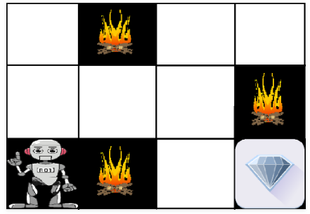
Example
The problem is as follows: We have an agent and a reward, with many hurdles in between. The agent is supposed to find the best possible path to reach the reward.
The above image shows robot, diamond and fire. The goal of the robot is to get the reward that is the diamond and avoid the hurdles that is fire. The robot learns by trying all the possible paths and then choosing the path which gives him the reward with the least hurdles. Each right step will give the robot a reward and each wrong step will subtract the reward of the robot. The total reward will be calculated when it reaches the final reward that is the diamond.

Slide 11
Main points in Reinforcement learning –
Input: The input should be an initial state from which the model will start
Output: There are many possible output as there are variety of solution to a particular problem
Training: The training is based upon the input, The model will return a state and the user will decide to reward or punish the model based on its output.
The model keeps continues to learn.
The best solution is decided based on the maximum reward.

Slide 12
Various Practical applications of Reinforcement Learning (RL) –
RL can be used in robotics for industrial automation.
RL can be used in machine learning and data processing
RL can be used to create training systems that provide custom instruction and materials according to the requirement of students.

Slide 13
Supervised Machine Learning
Supervised learning is where you have input variables (x) and an output variable (Y) and you use an algorithm to learn the mapping function from the input to the output.
Y = f(X)
The goal is to approximate the mapping function so well that when you have new input data (x) that you can predict the output variables (Y) for that data.

Slide 14
It is called supervised learning because the process of an algorithm learning from the training dataset can be thought of as a teacher supervising the learning process.
We know the correct answers, the algorithm iteratively makes predictions on the training data and is corrected by the teacher.
Learning stops when the algorithm achieves an acceptable level of performance.

Slide 15
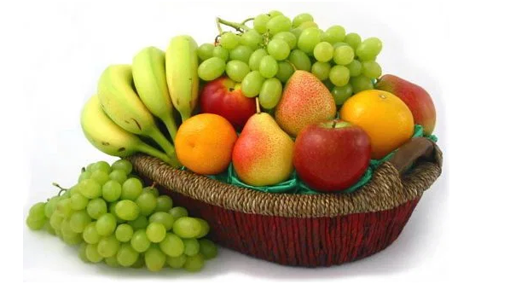
We have four types of fruits. They are: apple, banana, grape and cherry.
NO. | SIZE | COLOR | SHAPE | FRUIT NAME
1 | Big | Red | Rounded shape with a depression at the top | Apple
2 | Small | Red | Heart-shaped to nearly globular | Cherry
3 | Big | Green | Long curving cylinder | Banana
4 | Small | Green | Round to oval, Bunch shape Cylindrical | Grape

Slide 16
Suppose you have taken an new fruit from the basket then you will see the size , color and shape of that particular fruit.
If size is Big , color is Red , shape is rounded shape with a depression at the top, you will conform the fruit name as apple and you will put in apple group.
Likewise for other fruits also.
Job of groping fruits was done and happy ending.
You can observe in the table that a column was labeled as “FRUIT NAME” this is called as response variable.
If you learn the thing before from training data and then applying that knowledge to the test data(for new fruit), This type of learning is called as Supervised Learning.

Slide 17
Supervised learning problems can be further grouped into regression and classification problems.
Classification: A classification problem is when the output variable is a category, such as “red” or “blue” or “disease” and “no disease”.
Regression: A regression problem is when the output variable is a real value, such as “dollars” or “weight”.

